Slide 1


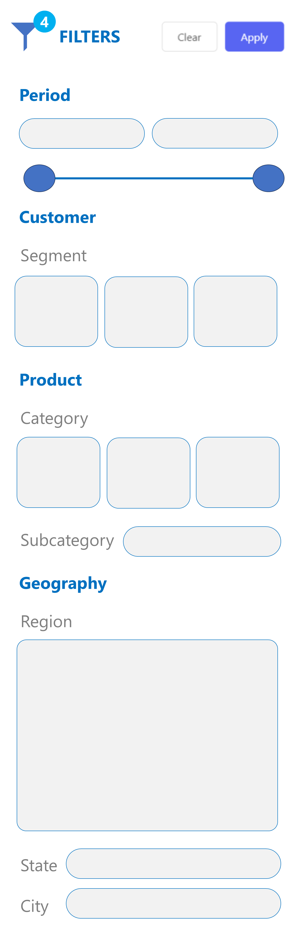

Slide 2


SUPERSTORE
Ask a question about your data

Slide 3


SUPERSTORE
Ask a question about your data

Slide 4
SUPERSTORE
Ask a question about your data

Slide 5
SUPERSTORE
Ask a question about your data

Slide 6
SUPERSTORE
Ask a question about your data

Slide 7
SUPERSTORE
Ask a question about your data

Slide 8
SUPERSTORE
Ask a question about your data

Slide 9
SUPERSTORE
Ask a question about your data

Slide 10
SUPERSTORE
Ask a question about your data

Slide 11
SUPERSTORE
Ask a question about your data

Slide 12
SUPERSTORE
Ask a question about your data

Slide 13
SUPERSTORE
Ask a question about your data

Slide 14

SUPERSTORE
Ask a question about your data

Slide 15
SUPERSTORE
Ask a question about your data

Slide 16
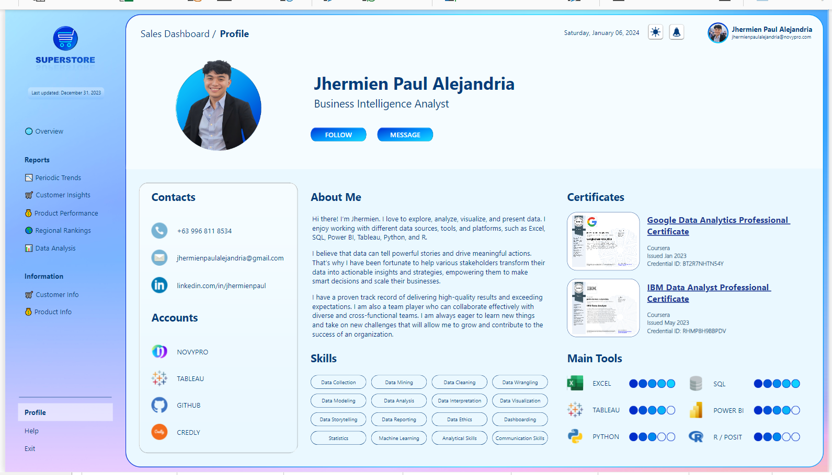
SUPERSTORE

Slide 17
SUPERSTORE

